Slide 1
Regulation of Enzyme Activity
1-regulation of enzyme quantity:
The amount of enzyme may be increased by increasing the rate of synthesis. Decreased by decreasing the rate of degradation.
A- Regulation by induction
Induction of synthesis of a particular enzyme.
The effector is called inducer (substrate, Hormone).
B-Regulation by repression:
Number of enzyme molecules decreased by repression. The effector is called repressor.

Slide 2
2- Allosteric Regulation
Allosteric Enzymes are regulated by molecules called allosteric effectors (also modifiers) that bind noncovalently at a site ( allosteric site ) other than the active site.
These enzymes are composed of multiple subunits, and the regulatory site that binds the effector may be located on a subunit that is not itself catalytic.

Slide 3
The presence of an allosteric effector can alter the affinity of the enzyme for its substrate, or modify the maximal catalytic activity of the enzyme, or both.
Effectors that inhibit enzyme activity are termed negative effectors, whereas those that increase enzyme activity are called positive effectors.

Slide 4
Allosteric effectors could be:
1. Homotropic effectors: When the substrate itself serves as an allosteric effector, the effect is said to be homotropic. Most often, an allosteric substrate functions as a positive effector.
2. Heterotropic effectors: The allosteric effector may be different from the substrate. Heterotropic effectors are commonly encountered,for example, the glycolytic enzyme phosphfructokinase allosterically inhibited by citrate, which is not a substrate for the enzyme

Slide 5
MODEL OF ALLOSTERIC REGULATION
Two main model have been proposed to describe the mechnastic basis of enzyme allostery:
1-Concerted model :
2-Sequential model:

Slide 6
Concerted ( Symmetry ) Model
For an enzyme consists of 2 identical subunits each with one active site. The subunits present in 2 conformations either T ( low affinity ) or R ( high affinity ).
An important assumption of the concerted model is that both subunits must be in the same conformational state: the binding of the first substrate molecule to one subunit increases the tendency of all subunits to undergo transition to the high affinity form through an all- or non – effect.
All subunits being either in the low affinity or high affinity forms. Therefore , in the concerted model, TT , RR conformations are allowed , but TR conformation is not permitted.

Slide 7
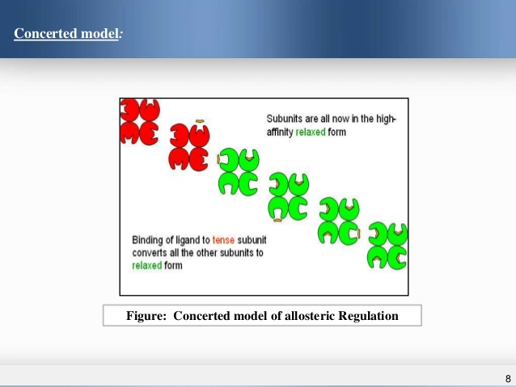

Slide 8
2. Sequential Model
It postulates that the subunits undergo individual sequential changes in conformation. The binding of the S molecule change the shape of the subunit to which is bound, However, the conformational state of the other subunit is not necessarily altered. Thus, TR conformation is allowed in addition to TT and RR conformations.

Slide 9
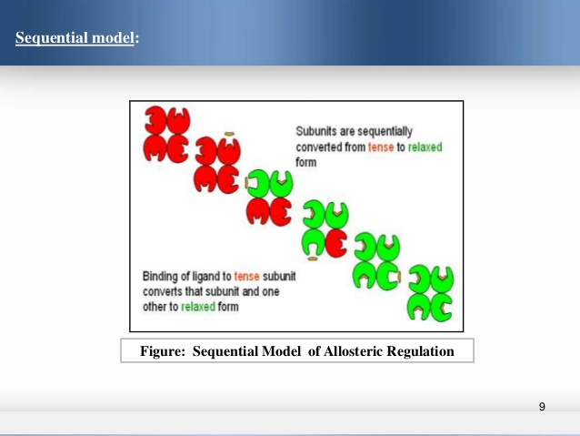

Slide 10
3-Feedback inhibition:
The end product of metabolic pathway results in allosteric inhibition of the first enzyme in the pathway.
Example :
For a biosynthetic pathway from A to D
Enz 1 Enz 2 Enz 3
A B C D
High concentration of D typically inhibit Enzyme 1

Slide 11
4-Zymogens ( Proenzymes) :
Are enzymes which are synthesized initially in an inactive form, and then activated at physiologically appropriate time and place.
The classical examples are the digestive enzymes: Pepsin , Trypsin and Chymotrypsin which are secreted in an inactive forms .
Modes of activation :- Could be
Exocatalysis :
when a zymogen is activated by another substance.
Autocatalysis:
when a zymogen is activated by it's already activated precursors.

Slide 12
Examples:
1) HCL “ exocatalysis”
Pepsinogen pepsin
2) Pepsin “ autocatalysis”
1) Enterokinase “ exocatalysis”
Trypsinogen Trypsin
2) Trypsin “ exocatalysis”
Trypsin “ exocatalysis”
Chymotrypsinogen Chymotrypsin

Slide 13
5-Covalent Modification :-
This is done by reversible covalent insertion of a small group ( ex. phosphate) on certain amino acid residue of an enzyme ( ex. serine, threonine, tyrosine, histidine) resulting in modulation of their activity.
Enzymes undergo covalent modification are called Interconvertable enzymes existing in 2 states of activity:
one of high catalytic activity and the
other of low catalytic activity.

Slide 14
ISOENZYMES
Definition:
- The multiple forms of an enzyme catalyzing the same reaction are isoenzymes .
-Isoenzymes may be present in different tissues of the same organism, in different cell types or subcellular compartments.
Besides the source, they also differ from each other with respect to their structure, electrophoretic mobility and immunological properties.

Slide 15
Lactate dehydrogenase (LDH) :
There are 5 isozymes of LDH ( 1- 5 ), separated by electrophoresis, all catalyses the same reaction:
LDH
Lactate + NAD⁺ pyruvate + NADH + H⁺
Each isozyme consists of 4 polypeptide chains: H and/or M

Slide 16
LDH ISOZYMES
Isozyme No. Subunits Organ Clinical Significance
1 HHHH Heart Myocardial Infarction
2 HHHM Heart, Kidney RBCs Myocardial Infarction
Renal cortex infarction, Haemolytic anaemia,
3 HHMM Widely distributed Little significance
4 HMMM Widely distributed Little significance
5 MMMM Liver, skeletal muscle Acute hepatitis, Acute muscle injury,
Muscle diseases

Slide 17
Creatine Phosphokinase (CPK)
( Creatine Kinase) ( CK)
There are 3 CK isozymes ( CPK 1 – 3 ) separated by electrophoresis, all catalyzes the same reaction:-
CPK
Creatine + ATP phosphocreatine + ADP
Mg²⁺
Each isozyme consists of 2 polypeptide chains : B and/or M

Slide 18
CPK ISOZYMES
Isozyme No. Subunits Organ Clinical Significance
1 BB Brain Brain disease, Severe shock
2 MB Heart Myocardial Infarction
3 MM Skeletal muscle Acute muscle injury, Muscle disease,

