Slide 1
Bial's & Seliwanoff’s Tests
Ass.lec:Dhuha fadhil
MSc. Clinical chemistry

Slide 2
Bial’s test (Orcinol)
Bial’s test is a chemical test performed to detect the presence of pentoses
Objective
To distinguish between the pentoses and hexoses.
Reagent
Bial's reagent consist of a solution of orcinol, HCl and ferric chloride)

Slide 3
Principle
pentoses are dehydrated by concentrated acid to yield furfural, which in turn condense with orcinol to form a blue-green precipitate.
In the presence of hexoses, hydroxyfurfural is formed instead of furfural which upon condensation with orcinol forms a muddy brown colored precipitate.
The intensity of the precipitation is directly proportional to the concentration of the pentoses in the sample.

Slide 4
bial’s test is a sensitive and specific test for pentoses sugars(ribose, ribulose, xylose, and arabinose)and other biochemical molecules containing these pentoses(what are they?)
Pentoses give blue-green color complex within short time, some hexoses in prolonged heating yield hydroxymethylfurfural which react with orcinol to give muddy brown color complex.

Slide 5
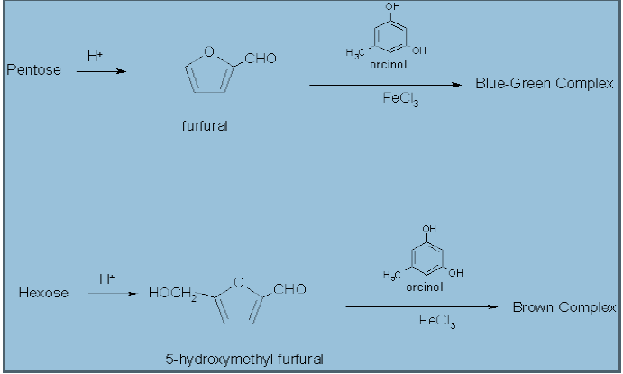
The reaction

Slide 6
Procedure
1) to 2 ml of Bial’s reagent add (5drops) of test solution(ribose or fructose) and warm gently in a hot water bath for 1-2 minutes.
2) a bluish – green color indicates a positive result (pentoses). Prolonged heating form muddy brown products indicates (hexoses).
NOTE:-
The dehydration agent is HCL.
The condensation agent is orcinol and ferric chloride.

Slide 7
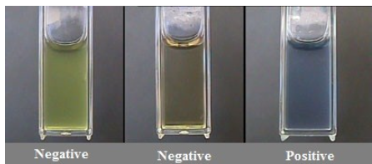
Result interpretation
Positive Bial’s test: formation of blue color ( eg. Ribose sugar)
Negative Bial’s test: formation of any other color indicates negative test. Hexose sugar ( glucose, fructose) generally gives green, red or brown color product.

Slide 8
Uses of Bial’s Test
This test is used to detect the presence of pentose in a given sample
This test can additionally be used for the quantification of RNA in a sample.

Slide 9
Seliwanoff's (resorcinol) Test
used to distinguish between aldoses (like glucose, galactose and mannose) and ketoses ( fructose & sucrose).
This test is based on the idea that in the presence of heat, ketoses become more quickly dried than aldoses.
Therefore this test is timed color reaction specific for ketohexoses.

Slide 10
Objectives of Seliwanoff’s test
To determine the presence of ketohexoses within the sample.
To differentiate between ketoses and aldose.

Slide 11
principle
Test uses HCl as dehydrating agent and resoncinol as condensation agent(Reagent). The test reagent dehydrates ketohexoses to form 5-hydroxymethylfurfural.
5-hydroxymethylfurfural further condenses with resorcinol present in the test reagent to produce a cherry red product within two minutes.
Aldohexoses react to form the same product, but do so more slowly giving A faint pink to yellow yellow color complex

Slide 12
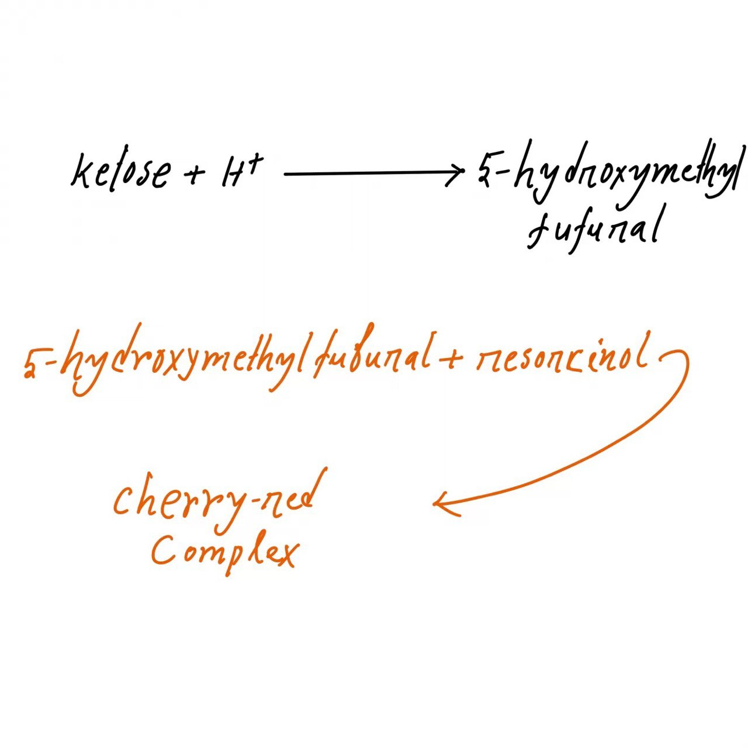

Slide 13
On dehydration both ketohexoes and aldohexoes give hydroxymethyl furfural but the relative amount of this product is vary according weather one works with aldoses or ketoses.
Aldohexoes yeilding only small amount of the hydroxymethyl furfural which resposible for no significant change in the color or appearance of only light pink to yellow color which develop in longer time.

Slide 14
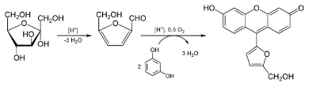
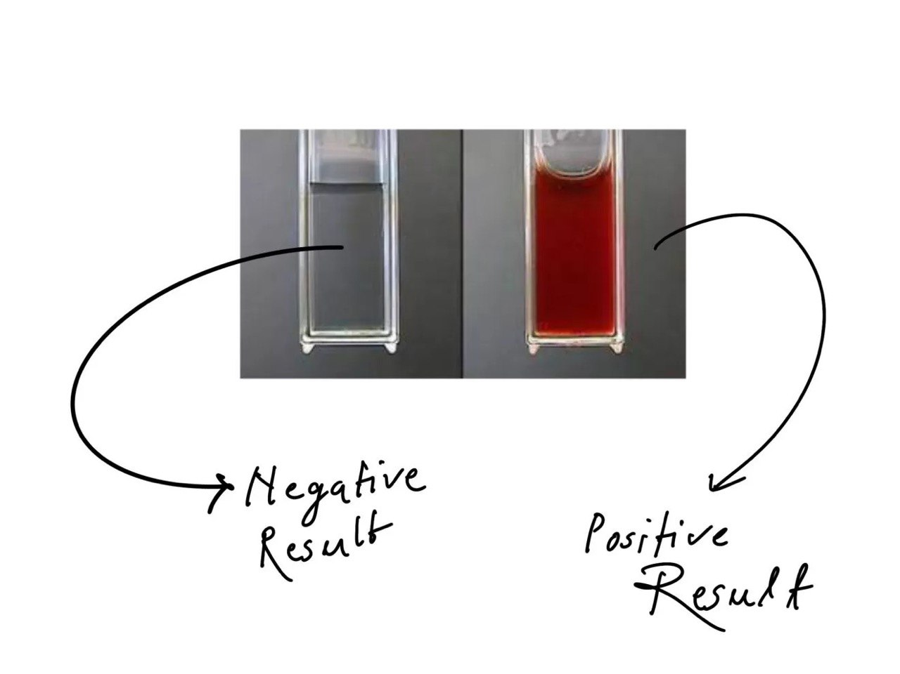
Figure: Seliwanoff’s test with fructose as an example.

Slide 15
Procedure
Take two clean, dry test tubes and add 1 ml of the test sample in one test tube and 1 ml of distilled water in another as blank.
Add 2 ml of Seliwanoffs’ reagent to both the test tubes.
Keep both the test tubes in a water bath for 1-2 min.
Observe the formation of color and note it down.

Slide 16
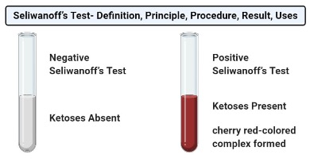
Result and Interpretation of Seliwanoff’s test
appearance of the color after a prolonged period of time indicates a negative result which means that the test sample doesn’t have ketoses.

Slide 17
Limitations of Seliwanoff’s test
The high concentration of glucose or other sugar may interfere by producing similar colored compounds with Seliwanoff’s reagent.
Prolonged boiling can transform glucose to fructose by the catalytic action of acid and form cherry red-complex giving a false-positive result.
This test is a generalized test and doesn’t distinguish between specific ketoses, and a separate test is required for the particular ketose sugar identification.

