Slide 1
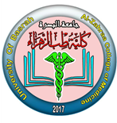

University of Basrah Al-zahraa medical college
Ministry of higher Education
and Scientific Research
The module: Mechanism of Disease
Session 5 / Lectures 1
Haemostasis and Thrombosis (I)
Module staff: Session 5
Dr. Sadiq K. Ali (Module leader)
Dr. Ihsan Mardan
Dr. Iman Abdul-Hadi
Dr. Ghada Lateef
Dr. Wasan Mansur
Dr. Safa Asaad
Robbin’s Basic pathology 9th edition
Hoffbrands Essential Haematology 7th edition

Slide 2
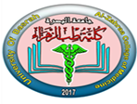
University of Basrah Al-zahraa medical college
Ministry of higher Education
and Scientific Research
Learning objectives:
Haemostasis;
Definition
Balance of coagulant and anticoagulant factors
Intrinsic and extrinsic pathways
Role of platelets
Fibrinolytic system
Thrombosis;
Definition
Predisposing factors
Effects of thrombosis
Outcomes

Slide 3
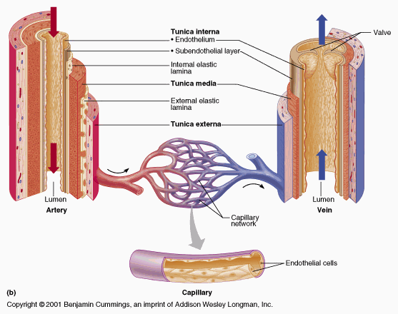

Slide 4
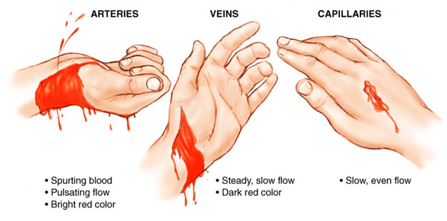
1- HAEMOSTASIS
Why don’t you bleed to death from a minor injury?

Slide 5
1- HAEMOSTASIS
Haemostasis refers more widely to the process whereby blood coagulation is initiated and terminated in a tightly regulated fashion, together with the removal (or fibrinolysis) of the clot as part of vascular remodelling.
The normal haemostatic response to vascular damage depends on a closely linked interaction between the blood vessel wall, circulating platelets and blood coagulation factors.

Slide 6
Haemostasis
Haemostasis consists of three steps:
• Vasoconstriction: this is mediated by reflex neurogenic mechanisms. Vasoconstriction reduces flow of blood, thus reducing extent of blood loss.
• Platelet plug (primary haemostasis): platelets adhere to the subendothelial collagen along with shape change and release of platelet granule contents.
• Activation of the coagulation cascade (secondary haemostasis): activation of the clotting cascade results in formation of fibrin and cross-linking of fibrin with resultant arrest of bleeding.

Slide 7
The haemostatic mechanisms have several important functions:
(1) to maintain blood in a fluid state while it remains circulating within the vascular system;
(2) to arrest bleeding at the site of injury or blood loss by formation of a haemostatic plug;
(3) to limit this process to the vicinity of the damage and
(4) to ensure the eventual removal of the plug whilst healing is completed

Slide 8
HAEMOSTASIS
There are at least five different components involved:
blood vessels,
platelets,
plasma coagulation factors and
their inhibitors and
the fibrinolytic system.
Deficiency or exaggeration of any one may lead to either thrombosis or haemorrhage

Slide 9
ENDOTHELIUM
Central regulators of haemostasis
The balance between the antithrombotic and prothrombotic activities of endothelium determines whether thrombus formation, propagation, or dissolution occurs.
At baseline, endothelial cells exhibit antithrombotic (antiplatelet, anticoagulant, and fibrinolytic properties), however, they are capable (after injury or activation) of exhibiting numerous procoagulant activities.

Slide 10
Antithrombotic Properties (Endothelium)
Antiplatelet effects
An intact endothelium prevents platelets (and plasma coagulation factors) from interacting with the highly thrombogenic subendothelial extracellular matrix (ECM).
Prostacyclin (PGI₂) and nitric oxide (NO).
Adenosine diphosphatase (ADPase).
Anticoagulant effects
Heparin-like molecules, thrombomodulin and tissue factor pathway inhibitor
Fibrinolytic effects
Plasminogen activator (t-PA)

Slide 12
Prothrombotic Properties (Endothelium)
Platelet effects: Endothelial injury brings platelets into contact with the subendothelial ECM, which includes among its constituents von Willebrand factor (vWF)
Procoagulant effects: In response to cytokines (e.g., tumour necrosis factor [TNF] or interleukin-1 [IL-1]) or certain bacterial products including endotoxin, endothelial cells produce tissue factor, the major in vivo activator of coagulation, and downregulate the expression of thrombomodulin.
Antifibrinolytic effects: Endothelial cells also secrete inhibitors of plasminogen activator (PAIs)

Slide 14
PLATELETS
Platelets play a critical role in normal haemostasis by forming a haemostatic plug that seals vascular defects, and by providing a surface that recruits and concentrates activated coagulation factors.
Normal platelet count is 150-400 x 10⁹/L.
After vascular injury, platelets encounter ECM constituents (collagen is most important) and adhesive glycoproteins such as vWF.

Slide 15
This sets in motion a series of events that lead to;
Platelet adhesion,
Platelet activation, and
Platelet aggregation.
Platelet Adhesion
Platelet adhesion initiates clot formation.
Adhesion to ECM is mediated largely via interactions with vWF that acting as a bridge between platelet surface receptors (e.g., GpIb) and exposed collagen.

Slide 16
Platelet Activation
Secretion of both granule types (α granules and δ granules) occurs soon after adhesion.
The subtle membrane changes include an increase in the surface expression of negatively charged phospholipids, which provide binding sites for both calcium and coagulation factors, and a conformation change in platelet GpIIb/IIIa that permits it to bind fibrinogen.

Slide 17
Platelet Aggregation
Aggregation follows platelet adhesion and granule release. In addition to ADP, platelet-synthesized thromboxane A₂ which is an important stimulus for platelet aggregation.
Aggregation is promoted by bridging interactions between fibrinogen and GpIIb/IIIa receptors on adjacent platelets.
ADP and TXA₂ promotes formation of an enlarging platelet aggregate, the primary haemostatic plug.

Slide 18
Thrombin binds to a platelet surface receptor (protease-activated receptor, or PAR); in association with ADP and TXA₂, this interaction induces further platelet aggregation. Platelet contraction follows, creating an irreversibly fused mass of platelets constituting the definitive secondary haemostatic plug.
Concurrently, thrombin converts fibrinogen to fibrin within and about the platelet plug, contributing to the overall stability of the clot.

Slide 19
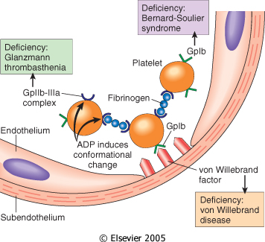

Slide 20
COAGULATION CACGADE
The coagulation cascade is a successive series of amplifying enzymatic reactions. At each step in the process, a proenzyme is proteolyzed to become an active enzyme, which in turn proteolyzes the next proenzyme in the series, eventually leading to the activation of thrombin and the formation of fibrin.

Slide 21
COAGULATION CACGADE
These components typically are assembled on a phospholipid surface and are held together by interactions that depend on calcium ions.
Once activated, the coagulation cascade must be tightly restricted to the site of injury to prevent inappropriate and potentially dangerous clotting elsewhere in the vascular tree.

Slide 22
In addition to the restriction of factor activation to sites of exposed phospholipids, three categories of natural anticoagulants function to control clotting:
antithrombins,
proteins C and S, and
tissue factor pathway inhibitor (TFPI).

Slide 23
Antithrombins (e.g., antithrombin III) inhibit the activity of thrombin and other serine proteases, factors IXa, Xa, XIa, and XIIa.
Proteins C and S are two vitamin K-dependent proteins that inactivate the cofactors Va and VIIIa.
Tissue factor pathway inhibitor (TFPI) is a protein secreted by endothelium (and other cell types) that inactivates factor Xa and tissue factor–factor VIIa complexes

Slide 25
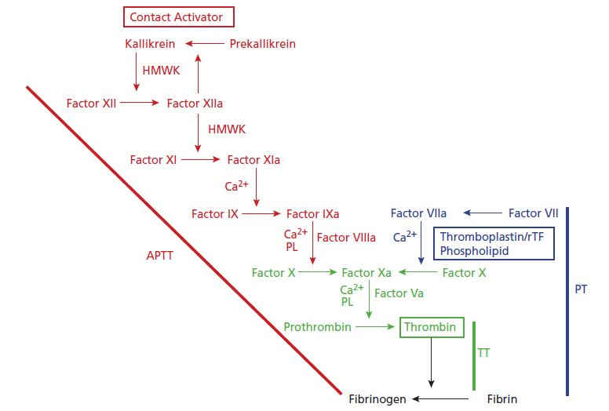
The coagulation cascade. The traditional concept of blood coagulation with separate intrinsic (red) and extrinsic (blue) pathways converging on the common pathway (green) with the generation of FXa.
PT= Prothrombin Time (10-12s)
APTT= Activated Partial Thromboplastin Time (26-40s)
TT= Thrombin Time (15-19s)

Slide 26
FIBRINOLYTIC SYSTEM
Fibrinolysis is largely carried out by plasmin, which breaks down fibrin and interferes with its polymerization
The resulting fibrin split products (FSPs or fibrin degradation products). Elevated levels of FSPs (most notably fibrin-derived D-dimers) can be used for diagnosing abnormal thrombotic states including disseminated intravascular coagulation (DIC), deep venous thrombosis, or pulmonary thromboembolism.

Slide 27
Plasmin is generated by proteolysis of plasminogen, an inactive plasma precursor, either by factor XII or by plasminogen activators:
Tissue-type plasminogen activator (t-PA)
Urokinase-like plasminogen activator (u-PA)
Streptokinase

Slide 28
To prevent excess plasmin from lysing thrombi indiscriminately throughout the body, free plasmin rapidly complexes with circulating α2-antiplasmin and is inactivated.
Endothelial cells further modulate the coagulation– anticoagulation balance by releasing plasminogen activator inhibitors (PAIs)
{PAIs increased by inflammatory cytokines that’s why thrombosis occurs in severe inflammation}.

Slide 29
Fibrinolytic system

Slide 30
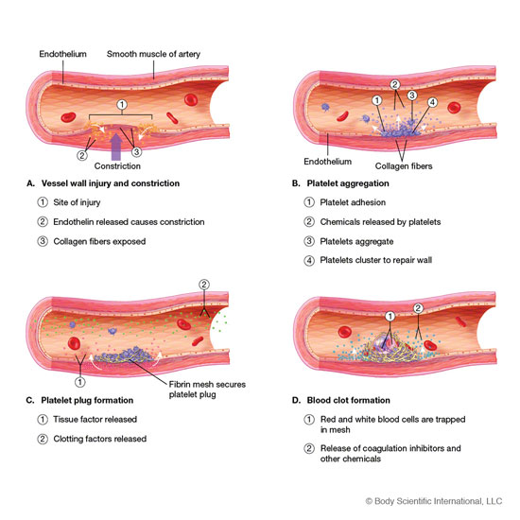

Slide 31


