Slide 1
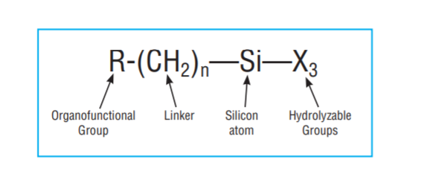
Chemistry of Silane Coupling Agents
What is Silane Coupling Agents
Silane coupling agents have the ability to form a durable bond between organic and inorganic materials . Encounters between dissimilar materials often involve at least one member that’s siliceous or has surface chemistry with siliceous properties; silicates, aluminates, borates, etc ., are the principal components of the earth’s crust . Interfaces involving such materials have become a dynamic area of chemistry in which surfaces have been modified in order to generate desired heterogeneous environments or to incorporate the bulk properties of different phases into a uniform composite structure .

Slide 2
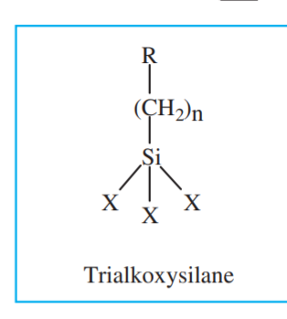
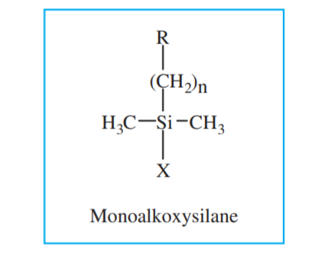
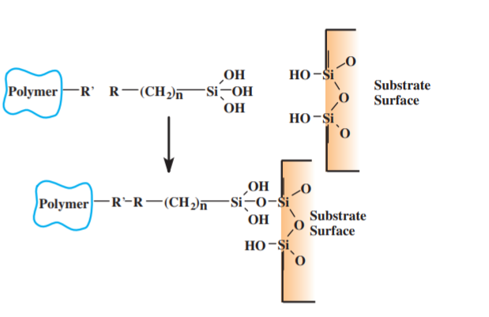
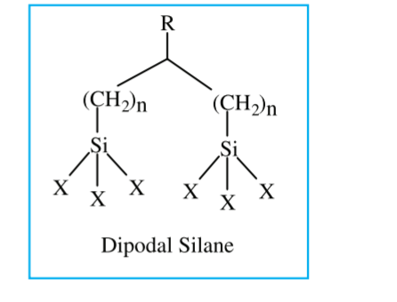
The general formula for a silane coupling agent typically shows the two classes of functionality. X is a hydrolyzable group typically alkoxy, acyloxy, halogen or amine. Following hydrolysis, a reactive silanol group is formed, which can condense with other silanol groups, for example, those on the surface of siliceous fillers, to form siloxane linkages. Stable condensation products are also formed with other oxides such as those of aluminum, zirconium, tin, titanium, and nickel. Less stable bonds are formed with oxides of boron, iron, and carbon. Alkali metal oxides and carbonates do not form stable bonds with Si-O-. The R group is a nonhydrolyzable organic radical that may posses a functionality that imparts desired characteristics

Slide 3
Cont.
How dose a Silane Modify a Surfuce
Most of the widely used organosilanes have one organic substituent and three hydrolyzable substituents. the alkoxy groups of the trialkoxysilanes are hydrolyzed to form silanol-containing species . Reaction of these silanes involves four steps . Initially, hydrolysis of the three labile groups occurs . Condensation to oligomers follows . The oligomers then hydrogen bond with OH groups of the substrate . Finally, during drying or curing, a covalent linkage is formed with the substrate with concomitant loss of water . The R group remains available for covalent reaction or physical interaction with other phases .
Silanes can modify surfaces under anhydrous conditions consistent with monolayer and vapor phase deposition requirements . Extended reaction times (4-12 hours) at elevated temperatures (50°-120°C) are typical . Of the alkoxysilanes, only methoxysilanes are effective without catalysis for vapor deposition . The most effective silanes for vapor phase deposition are cyclic a zasilanes .

Slide 4
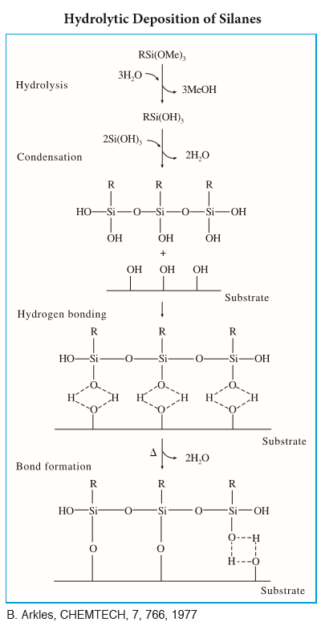

Slide 5
Selective asilane for surface modification
There are several factors influence surface modification .
1- concentration of the surface hydroxyl group.
2-type of surface hydroxyl group.
3- hydrolytic stability of the bond formation.
4- physical dimension of the substrate .
Note … If the hydrolytic stability of the oxane bond between the silane and the substrate is poor or the application is in an aggressive aqueous environment, dipodal silanes often exhibit substantial performance improvements . These materials form tighter networks and may offer up to 105x greater hydrolysis resistance making them particularly appropriate for primer applications .
Hydrolysis Conditions.
Water for hydrolysis may come from several sources . It may be added, it may be present on the substrate surface, or it may come from the atmosphere . The degree of polymerization of the silane is determined by the amount of water available and the organic substituent .

Slide 6
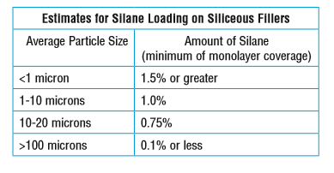
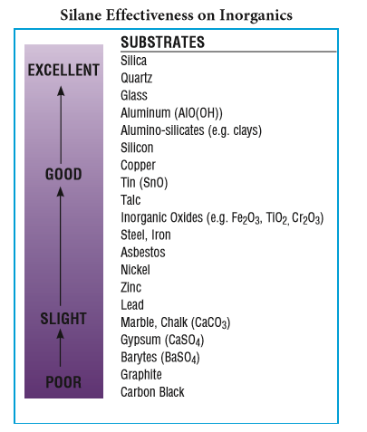
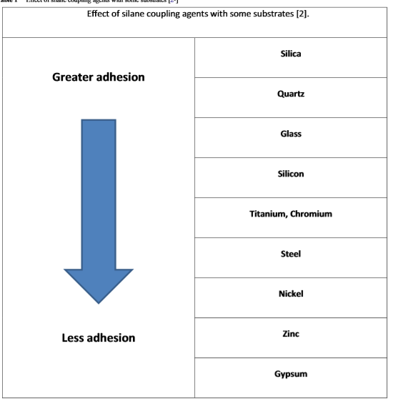

Slide 7
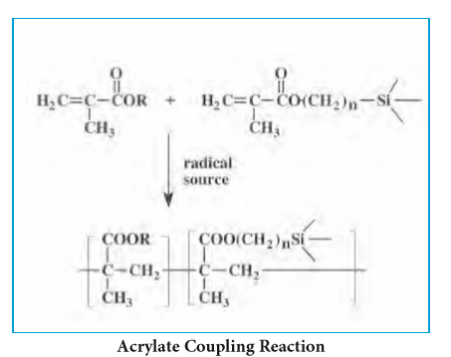
Coupling agents find their largest application in the area of polymers . Since any silane that enhances the adhesion of a polymer is often termed a coupling agent, The covalent bond may be formed by reaction with the finished polymer or copolymerized with the monomer.
1- Thermosets Polymers.
Here in this example , the R group of the SCA containing double bond , so the polymer used must be contain double bond like , acrylate , methyl acrylate and unsaturated polyester. owing to their facility for undergoing free-radical polymerization, can be modified by copolymerization with silanes that have unsaturated organic substitution.
In this case free radical polymerization accoure . And the covalent bond obtained between the silane and the polymer through the double bond.
Appliction of SCA With polymers
R-Group
substrate

Slide 8
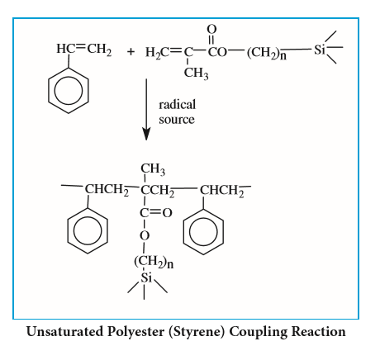
In the case of unsaturated polyester , styrene may be used as cross linking agent.
And the reaction accoure between the SCA and the polymers in the presence of suitable peroxide . As shown in this example. typically styrene . In general, better reinforcement is obtained when the silane monomer matches the reactivity of the styrene rather than the maleate portion of the polyester .
Peroxide initiater
substrate

Slide 9
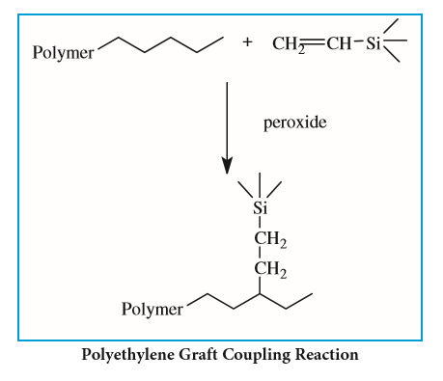
Some time they can be used in direct high pressure polymerization with olefins such as ethylene, propylene and dienes as shown in this example.
Here the initiator radical cleavage the double bond of the silane formation of free radical
and then link with olefin chain through the methylene group.
Methylene group

Slide 10
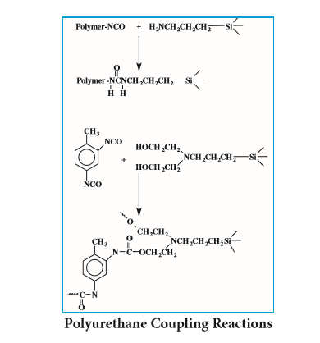
In the case of polyurethane
Thermoset urethane can be effectively coupled with two types of silanes . The first type, including isocyanate functional silanes, may be used to treat the filler directly or integrally blended with the diisocyanate (TDI, MDI, etc .) prior to cure . Amine and alkanolamine functional silanes, on the other hand, are blended with the polyol rather than the diisocyanate . Isocyanate functional silanes couple with the polyol . Alkanolamine functional silanes react with the isocyanate to form urethane linkages, while amine silanes react with the isocyanates to yield urea linkages . A typical application for coupled urethane system is improving bond strength with sand in abrasion-resistant, sand-filled flooring resins
.

Slide 11
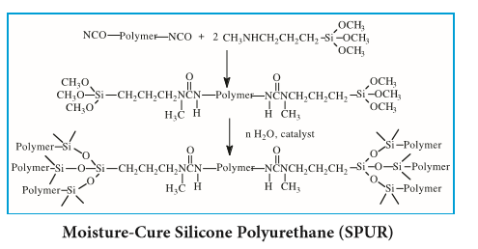
Moisture-Cureable Urethanes
Secondary aminosilanes have the general ability to convert isocyanate functional urethane prepolymers to systems that crosslink in the presence of water and a tin catalyst . The preferred aminosilanes are secondary containing methyl, ethyl or butyl substitutions on nitrogen .

Slide 12
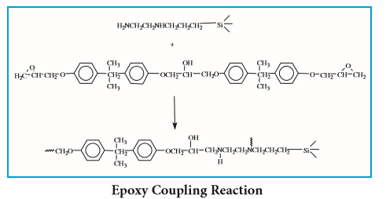
Epoxies
Epoxycyclohexyl and glycidoxy functional silanes are used to pretreat the filler or to blend with the glycidylbisphenol-A ether . Amine functional silanes can likewise be used to pretreat the filler or to blend with the hardener portion . Treatment of fillers in epoxy adhesives improves their dispersibility and increases the mechanical properties of the cured resin . A large application area is glass cloth-reinforced epoxy laminates and prepregs in aerospace and electrical printed circuit board applications
Note…..Some time the SCA containing epoxy group , in this mater the polymer here can be polyamine or polyether polyamine or any type of polymer terminated amine group or carboxylic groyp or mercapto

Slide 13
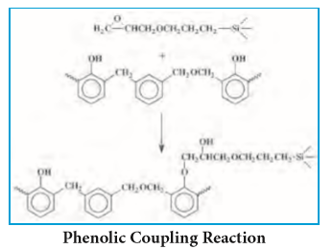
Phenolics
The phenolic hydroxyl group of the resins readily react with the oxirane ring of epoxy silanes to form phenyl ether linkages .
When phenolic resins are compounded with rubbers, as in the case with nitrile/phenolic or vinyl butyral/phenolic adhesives, or impact-resistant molding compounds, additional silanes, particularly mercapto-functional silanes, have been found to impart greater bond strength than silanes that couple to the phenolic portion .
Polymer

Slide 14
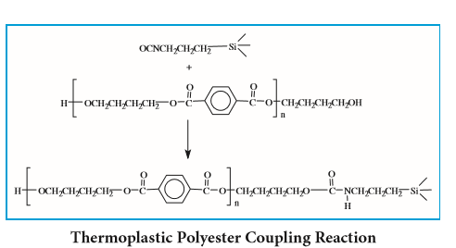
Thermoplastic Condensation Polymers
Most of the condensation polymers including polyamides, polyesters, polycarbonates, and polysulfones are in this group . Adhesion is promoted by introducing high energy groups and hydrogen bond potential in the interphase area or by taking advantage of the relatively low molecular weight of these polymers, which results in a significant opportunity for end-group reactions . Aminoalkylsilanes, chloroalkylsilanes, and isocyanatosilanes are the usual candidates for coupling to these resins . This group has the greatest mechanical strength of the thermoplastics, allowing them to replace the cast metals in such typical uses as gears, connectors and bobbins .

Slide 15
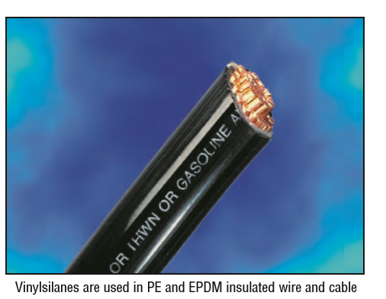
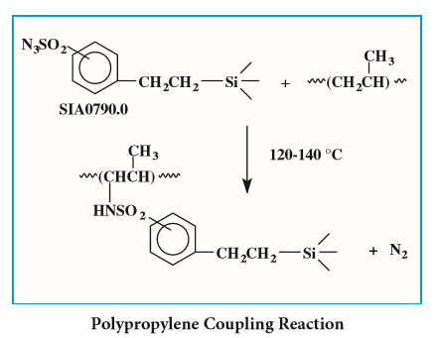
Polyolefins
The polyolefins and polyethers present no direct opportunity for covalent coupling . Until recently, the principal approach for composite formulation was to match the surface energy of the filler surface, by treating it with an alkylsubstituted silane, with that of the polymer . For optimum reinforcement, preferred resins should be of high molecular weight, linear, and have low melt viscosity
Another approach for coupling polypropylene and polyethylene is through silylsulfonylazides .

Slide 16
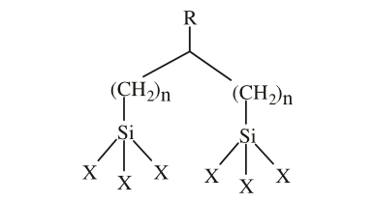
Dipodal silanes are a new series of adhesion promoters that have intrinsic hydrolytic stabilities up to ~10,000 times greater than conventional silanes . These products have a significant impact on substrate bonding and mechanical strength of many composite systems to include epoxy, urethane, epoxy/urethane hybrids, polysulfide, cyanoacrylate and silicone and may be utilized in water-borne, high solids and photo-active chemistries .
Note…The problem with conventional silanes is that silanols self condense to form siloxanes resulting in phase separation or gelation . Through the addition of dipodal silanes, the enhanced hydrolytic stability will have significant impact on shelf life, substrate bonding and improved mechanical strength of many composite systems .
Dipodal silanes
Different substrates, different conditions, varying silane combinations and finally the different applications all have an effect on dipodal silane selection . The key factors determining silane-dipodal silane mixtures are:
1 . Improved wet adhesion 2 . Improved chemical resistance 3 . Improved processing 4 . Improved coating performance (such as improved corrosion protection)

Slide 17
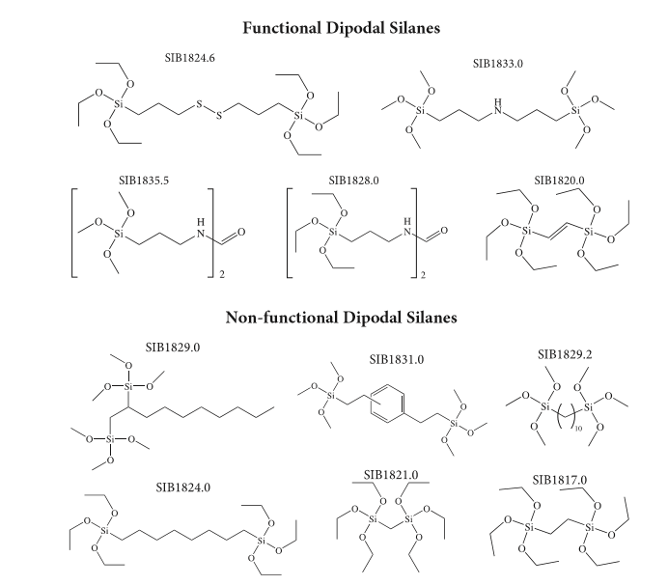

Slide 18
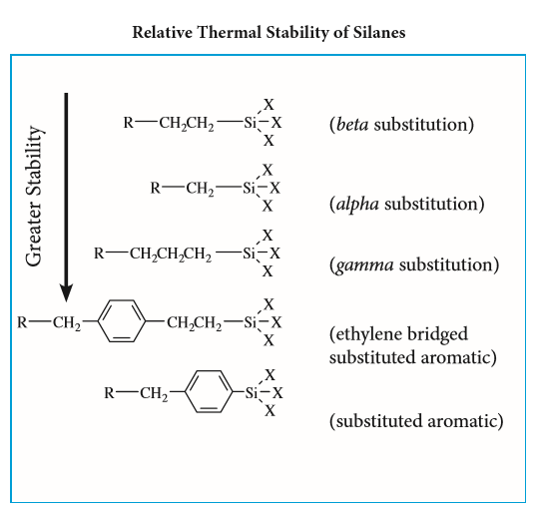
The general order of thermal stability for silane coupling agents is depicted .
Thermogravimetric Analysis (TGA) data for hydrolysates may be used for bench-marking . The specific substitution also plays a significant role in thermal stability . Electron withdrawing substitution reduces thermal stability, while electropositive groups enhance thermal stability .
.
Thermal stability of SCA

Slide 19
There are several methods used to modification of fillers using SCAincluding..
1- Deposition from aqueous alcohol solutions is the most facile method for preparing silylated surfaces . A 95% ethanol-5% water solution is adjusted to pH 4 .5-5 .5 with acetic acid . Silane is added with stirring to yield a 2% final concentration . Five minutes should be allowed for hydrolysis and silanol formation . Large objects, e .g . glass plates, are dipped into the solution, agitated gently, and removed after 1-2 minutes . They are rinsed free of excess materials by dipping briefly in ethanol . Particles, e .g . fillers and supports, are silylated by stirring them in solution for 2-3 minutes and then decanting the solution . The particles are usually rinsed twice briefly with ethanol . Cure of the silane layer is for 5-10 mins at 110°C or 24 hours at room temperature (<60% relative humidity) .
2- Deposition from aqueous solution is employed for most commercial fiberglass systems . The alkoxysilane is dissolved at 0 .5-2 .0% concentration in water . For less soluble silanes, 0 .1% of a non-ionic surfactant is added prior to the silane and an emulsion rather than a solution is prepared . The solution is adjusted to pH 5 .5 with acetic acid . The solution is either sprayed onto the substrate or employed as a dip bath . Cure is at 110-120°C for 20-30 minutes . Stability of aqueous silane solutions varies from 2-12 hours for the simple alkyl silanes . Poor solubility parameters limit the use of long chain alkyl and aromatic silanes by this method . Distilled water is not necessary, but water containing fluoride ions must be avoided .
3- bulk deposition onto powders, e .g . filler treatment, is usually accomplished by a spray-on method . It assumes that the total amount of silane necessary is known and that sufficient adsorbed moisture is present on the filler to cause hydrolysis of the silane . The silane is prepared as a 25% solution in alcohol . The powder is placed in a high intensity solid mixer, e .g . twin cone mixer with intensifier . The methods are most effective . If the filler is dried in trays, care must be taken to avoid wicking or skinning of the top layer of treated material by adjusting heat and air flow .
Surface modification of SCA

Slide 20
4- Integral blend methods are used in composite formulations . In this method the silane is used as a simple additive . Composites can be prepared by the addition of alkoxysilanes to dry-blends of polymer and filler prior to compounding . Generally 0 .2 to 1 .0 weight percent of silane (of the total mix) is dispersed by spraying the silane in an alcohol carrier onto a preblend . The addition of the silane to non-dispersed filler is not desirable in this technique since it can lead to agglomeration . The mix is dry-blended briefly and then melt compounded . Vacuum devolatization of byproducts of silane reaction during melt compounding is necessary to achieve optimum properties . Properties are sometimes enhanced by adding 0 .5-1 .0% of tetrabuty.
5- Chlorosilanes can also be deposited from alcohol solution . Anhydrous alcohols, particularly ethanol or isopropanol are preferred . The chlorosilane is added to the alcohol to yield a 2-5% solution . The chlorosilane reacts with the alcohol producing an alkoxysilane and HCl . Progress of the reaction is observed by halt of HCl evolution . Mild warming of the solution (30-40°C) promotes completion of the reaction . Part of the HCl reacts with the alcohol to produce small quantities of alkyl halide and water . The water causes formation of silanols from alkoxysilanes . The silanols condense on the substrate . Treated substrates are cured for 5-10 mins . at 110°C or allowed to stand 24 hours at room temperatur

Slide 21
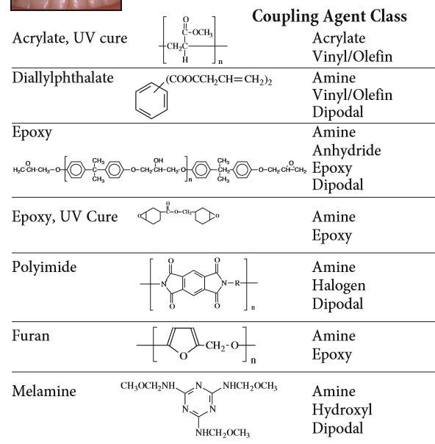
Selectivity of SCA against polymers

Slide 22
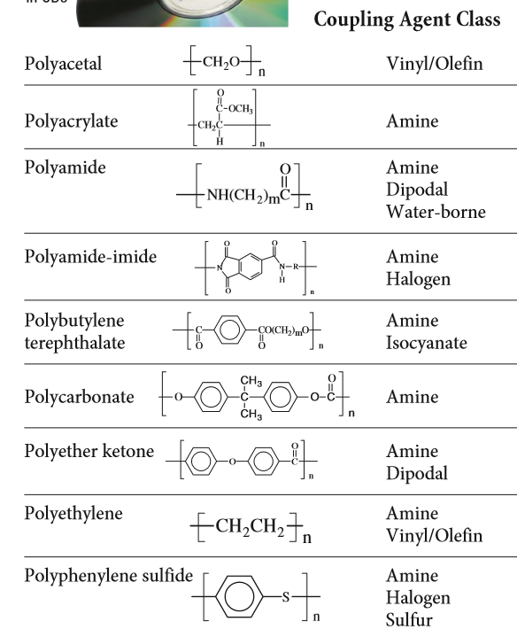

Slide 23
Thank You for your Attention
Dr.Widad .Saleh

