Slide 1
fetal membranes

Slide 2
Fetal membranes
The origin of the fetal membrane from the trophoblast
Temporary fetal membrane
  Yolk sac
Permanent fetal membrane
  Amnion
  Allantois
  Chorion

Slide 3
Yolk sac
  Origin : endoderm
  Stay for 4-6 weeks (after that there is no any effect for it)
  Food supplementation and play an important role for waste excretion
  Play a synergism with uterine milk for food supplementation

Slide 4
Amnion
  Origin : ectoderm
  Form between 13-16 day
  Completely surrounded the fetus in day 30 as transparent membrane except the ring of umbilical cord

Slide 5
Amnion
  This sac contain 2 layers:
    True amnion (formation of amniotic fluid)
      It has a plaques which is called Epithelial plaques
    False amnion (at first connect with chorion to form amniotic-chorion which assist for food supplementation and waste excretion)
  Filled with amniotic fluid, its functions:
    Mechanical support
    Prevent adhesion and facilitate the parturition

Slide 6
Allantois
  Origin : endoderm
  Form between 14-21 day
  Completely developed after day 35-40
  This sac contain 2 layers:
    The inner layer opposite the amnion
    The outer layer covered with blood supply and connect with chorion (allanto-chorion)
  From it the umbilical cord formed which connect with fetus

Slide 7
Allantois
  Filled with allantoic fluid which is the urine of fetus excrete from the kidney of fetus to the umbilical cord through urachus
  Ca precipitate in attantois after day 60
  It has an irregular masses which is called Hippomanes (0.5-15 cm in length )
  In many species the allantois connect with amnion in some sites (but not for mare which lead to a free movement of amnion inside the allantois )

Slide 8
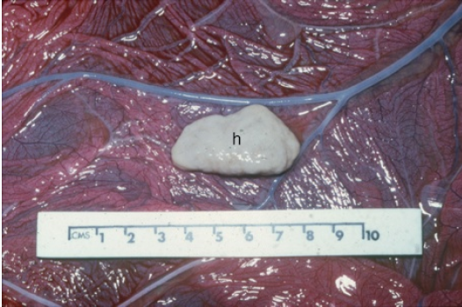

Slide 9
Chorion
  The outer sac of the fetal membrane
  Formed from the outer layer of trophoblast
  Highly supplied with blood vessels connect with allantois from the inner side and with uterus from the outer side
  Responsible for food, gas, waste exchange

Slide 10
connection between chorion and uterus
  Cotyledonary
    Cow, ewe, doe and buffalo
      In cow: concave cotyledon from the chorion attach with convex caruncle in uterus to form placentomes
      In sheep: convex cotyledon from the chorion attach with concave caruncle in uterus to form placentomes

Slide 11
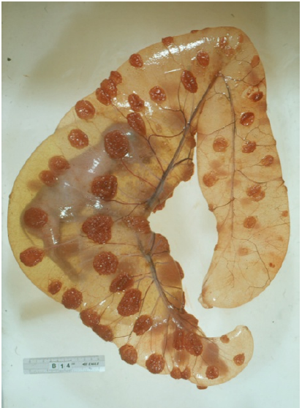

Slide 12
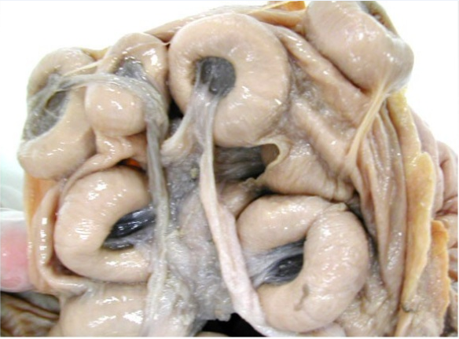

Slide 13
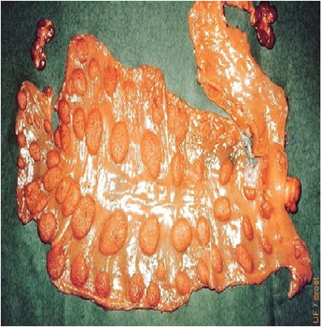
  The placentomes arrange in 4 rows (2 dorsal and 2 ventral)
    75 - 120 placentomes in cow
    80 - 90 placentomes in ewe

Slide 14
connection between chorion and uterus
  Diffuse
    Mare, sow and camel
    Villi distributed on chorion attach with crypts in the uterus
    All the surface of chorion and endometrium contribute to the function of placenta
    Cervical star (the area near the cervix which not contribute with the function of placenta and take a shape of star)

Slide 15
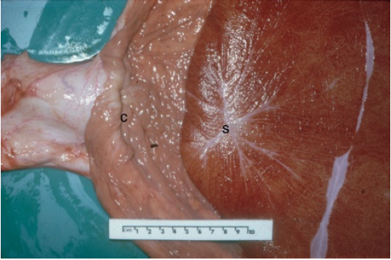

Slide 16
connection between chorion and uterus
  Zonary
    Bitch and queen
    Placenta take zone shape (1.5-7.5 cm) which surround the uterus
    The other parts of placenta don’t contribute with placenta function
    Hematoma in the edges of the placenta (source of iron for the fetus )

Slide 17
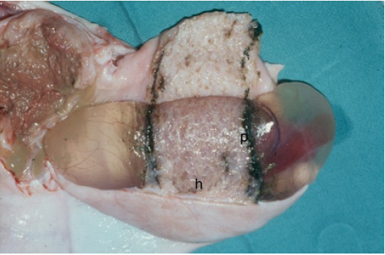

Slide 18
connection between chorion and uterus
  Discoidal
    Human, monkey and rodents
    Circular disc on chorion attach with circular area in the uterus
    This type of connection more tight from the other animals

Slide 19
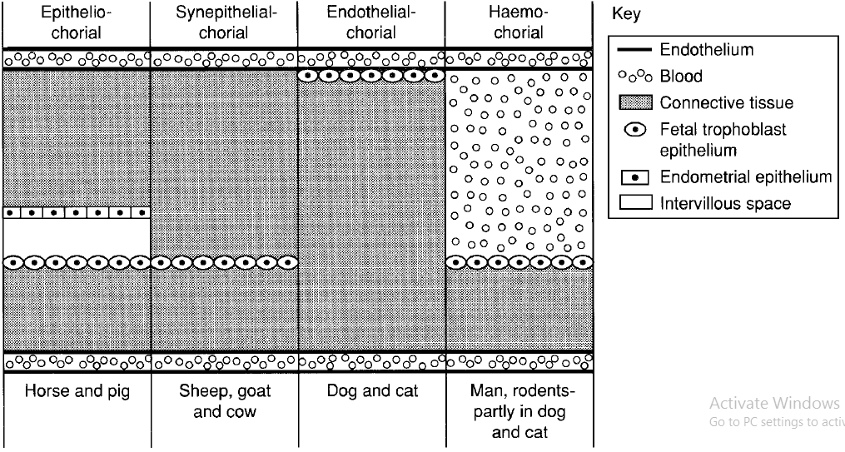
Histological classification of the placenta

Slide 20
Function of placenta
Food exchange to the blood of fetus and conversely
  Simple diffusion
  Active transport
  Phagocytosis
  pinocytosis

Slide 21
Function of placenta
Gas exchange between the blood of fetus and the blood of uterus
The O2 and CO2 diffused through the placenta and join with hemoglobin
The umbilical artery transfer the non oxygenated blood, while the umbilical vein transfer the oxygenated blood.

Slide 22
Function of placenta
Hormonal releasing function
  Estrogen
  Progesterone
  PMSG
  HCG
  Relaxin

Slide 23
FETAL FLUID
  Amniotic fluid
    Colorless, transparent and mucoid
    The volume of this fluid reach:
      In cow 2-8 liter
      In buffalo 3-4 liter
      In mare 3-7 liter
      In ewe and doe 0.5-1.5 liter
      In bitch and queen 25-50 ml
      In sow 100-200 ml

Slide 24
FETAL FLUID
  Amniotic fluid
    Its composition water, salts, fats, albumin and enzymes
    Functions
      Anti microbial
      Prevent adhesion between fetus and fetal membrane
      Mechanical support from external exposed
      Facilitate the parturition in the final stage of pregnancy

Slide 25
FETAL FLUID
  Amniotic fluid
    Its source:
      Endothelium of amnion sac (till the mid of pregnancy)
      Excretion from the urine of fetus
      Saliva and the secretion of nose
    Hydro-amnion (fetal monster ) 8-10 times
    Greenish-yellow amnion (meconium) deal with dead fetus
    Wool-ball in amnion deal with fetal gigantism

Slide 26
FETAL FLUID
  Allantoic fluid
    Yellowish, transparent and watery
    The volume of this fluid reach:
      In cow 4-15 liter
      In buffalo 5-15 liter
      In mare 8-18 liter
      In ewe and doe 0.5-1.5 liter
      In bitch and queen 10-50 ml
      In sow 100-200 ml

Slide 27
FETAL FLUID
  Allantoic fluid
    Its source:
      Urine of fetus (urea, albumin and fructose)
      Excretion from allantois sac (first stage of pregnancy)
    Hydro-allantois (defect in blood supply of allantois ) which may be reach 40-160 liter

Slide 28
POSITION OF THE UTERUS DURING THE PREGNANCY PERIODS
    The position of uterus changed as a result of increasing in the weight of fetus and the component of pregnant uterus
      Firstly the position of the uterus in the base pelvis
      First 30 day : the greater curvature of uterus displaced to the lateral position
      Between 60-75 day the uterus stay in the pelvic brim
      After 75 day : the uterus move toward the abdomen (descending stage) as a result of increasing in the weight of uterus and fetus

Slide 29
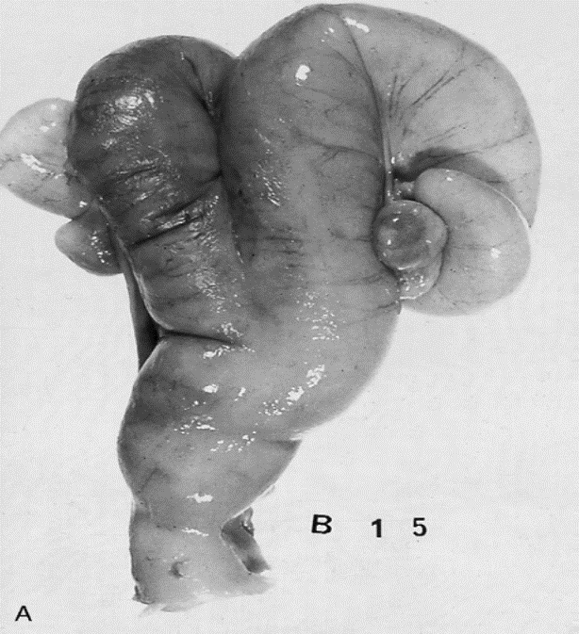

Slide 31
POSITION OF THE UTERUS DURING THE PREGNANCY PERIODS
    Descending stage continue gradually and lastly the uterus reach the base of abdomen in 130-140 day
    After 140 day : the uterus move anteriorly toward the diaphragm
      Difficulties to palpate the fetus and the ovaries
      Tension in uterine cervix
    After 210 day : the uterus move toward the pelvis (ascending stage) as a result of enlargement in the size of fetus

Slide 33
POSITION OF THE UTERUS DURING THE PREGNANCY PERIODS
    After the 8th month : the fetus extend to the posterior side of the animal
    After the 9th month : the nose and the fore limb of the fetus stay on the pelvis

Slide 34
POSITION OF THE UTERUS DURING THE PREGNANCY PERIODS
    Exceptions:
      In nulliparous animals the pregnant uterus stay in the pelvis till the 4th month of pregnancy
      In pluriparous animals the non pregnant uterus stay in the pelvic brim and the uterus move toward the abdomen after the first month of pregnancy

Slide 36
POSITION OF THE fetus in the uterus
    In the first 4-5th month of pregnancy the fetus smaller than the uterus
      Take any position inside the uterus
    After the 5th month of pregnancy the diameter of fetus larger than the uterus
      The fetus determine its position inside the uterus
        In cow, ewe and doe the dorsal side of the fetus opposite the greater curvature of the uterus while the ventral side of the fetus opposite the lesser curvature of the uterus

Slide 37
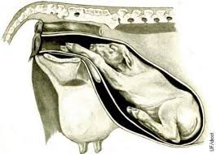

Slide 38
POSITION OF THE fetus in the uterus
    In mare, bitch and queen the ventral side of the fetus opposite the greater curvature of the uterus while the dorsal side of the fetus opposite the lesser curvature
      In these animals and near parturition take the normal position (the dorsal side of the fetus opposite the greater curvature of the uterus while the ventral side of the fetus opposite the lesser curvature of the uterus)
      This approach occur through the rotation of the fetus inside the uterus either before parturition or during parturition

Slide 39
POSITION OF THE fetus in the uterus
    In cows after the 6th month of pregnancy 95% of fetuses come in anterior presentation while 5% in posterior presentation
      Before the 6th month of pregnancy this percentage of anterior and posterior presentation is equal (50% for each one)
    In mares during the 7th month of pregnancy 66% of fetuses come in anterior presentation, and this percentage reach 99% in 9th month of pregnancy
    The percentage of anterior presentation in ewes 95%, in bitch 70%, in sow 50%
    Some of posterior presentation cases its parturition normally

