Slide 1
Cloning or somatic cell nuclear transfer (SCNT)

Slide 2
Cloning
Making a biological copy of another organism with the identical genetic makeup of the donor
Asexual method of reproduction
Natural examples of cloning include organisms such as bacteria and yeast
Animal cloning refers to the creation of a new genetic organism of an original living or dead animal
The only clones produced naturally in mammals are identical twins

Slide 3
Cloning
Cloned animals can be created by three processes:
Cloning by embryo splitting involves the division of the preimplantation embryo into equal halves, which produce two genetically identical embryos
Cloning by blastomere dispersal begins with the mechanical separation of individual cells prior to the formation of the blastocyst
Cloning by nuclear transfer (NT) is a delicate series of events that take place in a short period of time but have long-lasting effects on development

Slide 4
Cloning
Normal Fertilization
Oocyte maturation (reach to the metaphase II)
After sperm penetration there are three important things occur:
1- The oocyte start to complete the second meiotic division which lead to form ova
2- Connection between ova nucleus and sperm nucleus to form zygote
3- The oocyte activation occur (ca oscillation) which lead the zygote division will be start and form embryo

Slide 5
Cloning
Cloning requirement (induce clone embryo)
Oocyte maturation
Oocyte reach to the metaphase II
How can we restore the total number of chromosomes
Remove the chromosomes of oocyte and introduce a somatic cell with total number of chromosomes
Induce artificial oocyte activation
The oocytes which had the total number of chromosomes will be start to divide to form embryo
In vitro culture of embryo (for 7 days)
Transfer of embryo to synchronize surrogate mother

Slide 6
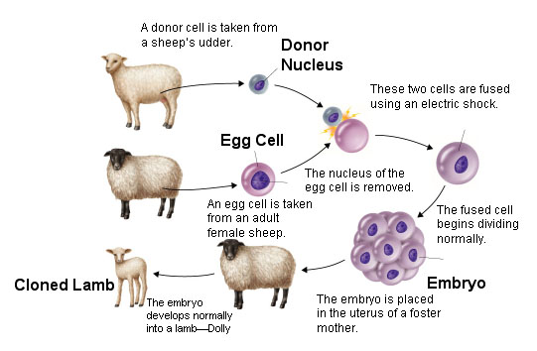
CLONING

Slide 7
In vitro maturation (ivm)
Immature aspirated oocytes expose for maturation inside special media for 20-24 hrs
The component of this media include:
TCM (tissue culture media)
FBS (fetal calf serum)
sodium pyruvate
Hormones (LH, FSH, Estradiol)
Antioxidant (Cysteamine)
Growth factor

Slide 8
1-In vitro maturation (ivm)
What's the meaning of mature oocytes ?
Immature oocytes enter to the first meiotic division and stopped in prophase I
Induce maturation mean move the meiosis I to complete
Metaphase I
Anaphase I
Telophase I
In the end of this division the oocytes enter the second meiotic division and stop again in metaphase II
So the mature oocytes mean the oocyte in metaphase II which has the first polar body

Slide 9
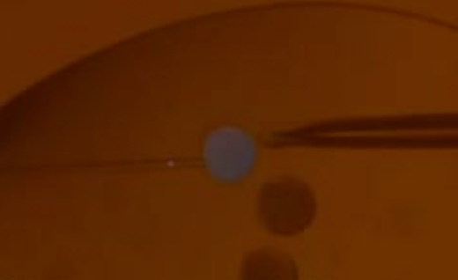
2-Enucleation
The complete removal of genetic material (chromosomes) from a matured oocyte to produce an enucleated oocyte (cytoplast)
Two methods for enucleation
1- Enucleation through micromanipulator by aspiration the nuclear material after staining the chromosomes

Slide 10
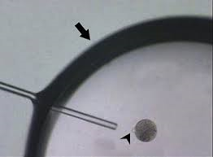
2-Enucleation
2- Enucleation through manual enucleation by aspiration the nuclear material manually after treatment with demecolcine

Slide 11
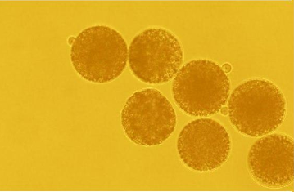
3-somatic cell introducing
The removed genetic material replaced by somatic cell (karyoplast) from the donor animal which containing the full number chromosomes
The karyoplast introduce into the cytoplast through:
1-Direct microinjection (through micromanipulator)
2- By fusion between the cytoplast and karyoplast by electro-fusion which include:
cell attachment
Electro-cell fusion

Slide 12
4- artificial oocyte activation
The couple activate artificially by a variety of physical and chemical agents for inducing calcium oscillations like (ionomycin or Ca ionophore) followed by a treatment with 6-DMAP for 4 hours

Slide 13
5- in-vitro culturing
The reconstructed embryo (the couple after fusion and activation) introduce for in vitro culturing inside especial media which is synthetic oviductal fluid (SOF) in a controlled atmosphere of 5% CO2 and 5% O2 for 7 days
The embryo implanted in another adult female for normal gestation and delivery

Slide 14
Applications of cloning
Making Clones for Animal Research Purposes
When the animals used in experiments are exactly the same physiologically, the experiments are much easier to control and fewer animals are needed
Propagating Desirable Stocks
In animal breeding strategies, rapid spread of desirable traits within stocks of domestic animals is of obvious commercial importance

Slide 15
Applications of cloning
Improving Generation and Propagation of Transgenic Livestock
Transgenic technology developed to add genes and introduce into cell lines in culture, and cells containing the transgene use as a source of cloning to ensuring that all offspring are transgenic
Generating Targeted Gene Alterations
Repopulating Endangered Animals and Bringing Animals Back from Extinction
An possibility offered by the nuclear transfer procedure is the making of interspecific hybrids, that is, the use of oocytes (recipient cytoplasts) from different species and donor cells from that animal

Slide 16
Factors Affecting Efficiency of cloning
Clonability of Different Species
Cloning in goat easier than cow and difficult in human (the cytoplasm of oocyte in goat easily can reprogram the somatic cell)
Source of Oocytes
From live animal (matured) or from the slaughterhouse (induce maturation) and the maturation important for successing
Donor Cell Type
Fibroblast cell is better than other cells (easily divided), also we can use cumulus cells and endothelial cells
Cell Cycle Coordination
It is important to use cell in stage G0 (if it is in another stage it cant divide)

Slide 17
Embryo Bisection (embryo splitting)

Slide 18
Embryo splitting
Embryos from some mammalian species can be divided in two halves
Each one called (Demi embryos) and can develop into identical twins
Embryo splitting is usually accomplished at the late morula or blastocyst stage prior to hatching from the zona pellucida
Embryo splitting required two micromanipulators
One with an aspiration pipette attached
The other with a microsurgical blade

Slide 19
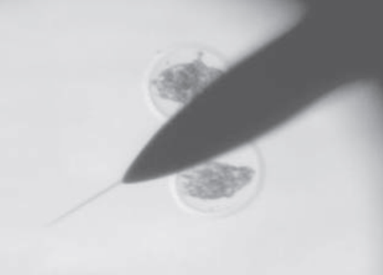
Embryo splitting
A metal microsurgical blade used in this approach

Slide 20
Embryo splitting
This technique used to increase the total number of transfers from a valuable donor animal
Splitting embryos increase the total number of embryos
Survival rate of each demi-embryo is lower than non-splitting embryos
Insufficient number of viable cells to sustain normal development
Smaller embryonic mass provides a weaker anti-luteolytic signal, which is essential for the maintenance of pregnancy or inadequate signalling for maternal recognition of pregnancy

