Slide 1
General Methods of Extraction and Isolation of Alkaloids
Ph Faten Essam
MSc pharmacy science

Slide 2
Alkaloids
Alkaloids are large group of basic organic compounds containing one or more nitrogen atom usually in a hetero cyclic ring, most of them have a marked physiological action on human beings or animals
The general structure is R-N.

Slide 3
Functions of alkaloids in plants
1. They may act as protective against insects and herbivores due to their bitterness and toxicity.
2. They are, in certain cases, the final products of detoxification therefore considered as waste products of metabolism.
3. They may provide nitrogen to the plant in case of nitrogen deficiency (source of nitrogen).
4. They, sometimes, act as growth regulators in certain metabolic systems.
5. They may be utilized as a source of energy

Slide 4
Forms of Alkaloids
Alkaloids present In plant as :
Free base
Salts
Glycosidal form like Solanine in Solanum

Slide 5
Solubility of alkaloids
Both alkaloidal bases and their salts are soluble in alcohol.
Solubility of free base alkaloids
Generally, the bases are soluble in organic solvents and insoluble in water

Slide 6
Exceptions:
Bases soluble in water: caffeine, ephedrine, codeine, colchicine, pilocarpine and quaternary ammonium bases.
Bases insoluble or sparingly soluble in certain organic solvents: morphine in ether, theobromine and theophylline in benzene.

Slide 7
Solubility of salts
Salts are usually soluble in water and, insoluble or sparingly soluble in organic solvents
Exceptions:
Salts insoluble in water: quinine mono sulphate.
Salts soluble in organic solvents: lobeline and ap-oatropine hydrochlorides are soluble in chloroform.

Slide 8
Notes
Alkaloids occurs in plants, usually in mixtures of related compounds such as tannins, proteins, fats, resins, and pigments, which generally hinder their isolation.
Alkaloids react with acids to from salts.
Alkalis liberate most alkaloids from their salts e.g .NH3.
The use of strong alkali is not recommended incase of fatty drugs (e.g .seeds), to avoid saponification, which results in strong emulsions during extraction.
Ammonia is one of the choicest alkali as it is sufficiently basic to liberate most alkaloids, as well as, volatile and completely removed after extraction

Slide 9
Extraction of alkaloids
The extraction by fractional extraction (From less Polar to more Polar).
1-Defeating by non-polar solvent (Petroleum Ether, benzene, hexane,….) To get rid of Chlorophyll, Wax, Volatile oil, Fixed oil.
2-Filtration, for marc use methanol or ethanol 95% Evaporate by rotary evaporator (to Concentrate).
3-Add Tartaric acid 2% and Ethyl acetate will separate into two layers

Slide 10
Organic layer (For week or neutral alkaloids)
-Aqueous layer (acidic layer, Tartaric acid) which have alkaloidal salt. To break the salt, add NH3 or Sodium bicarbonate. then add ethyl acetate again so will it separate into two layers again:
Aqueous layer (Quaternary alkaloids 4º)
Organic layer (For basic alkaloid 1º ,2º,3º).

Slide 11
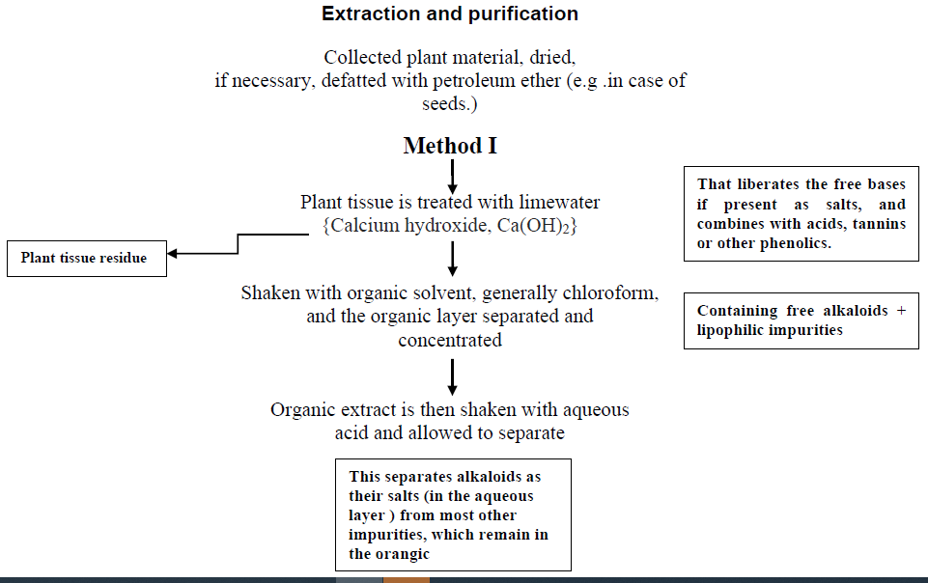

Slide 12
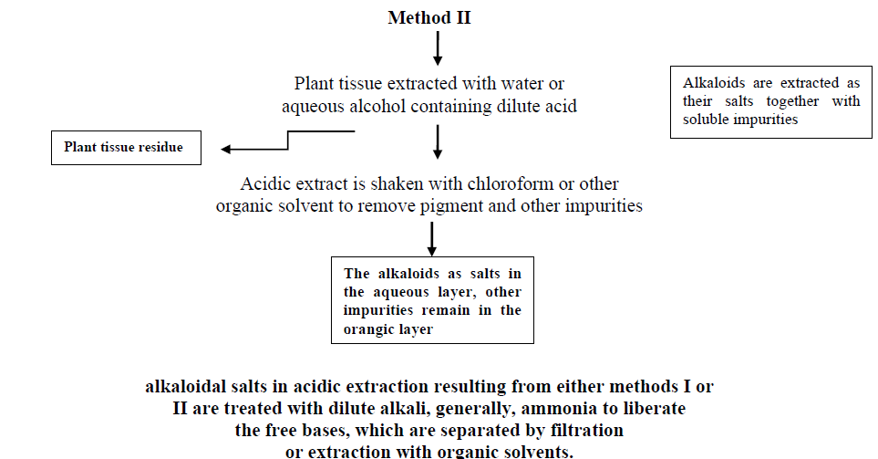

Slide 13
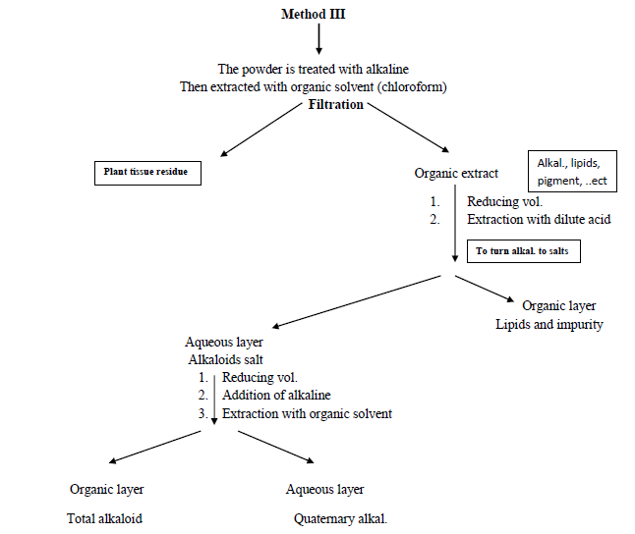

Slide 14
Detection of alkaloid
Wagner's test: Reddish brown precipitate.
Mayer’s: (HgCl2 Creamy precipitate with True alkaloid).
Dragendroff: (Potassium Bismuth Iodide) Reddish Brown precipitate
Hagger's test: (Picric acid) Yellow precipitate with True alkaloid.
Tannic acid solution: different alkaloid colored precipitate.

Slide 15
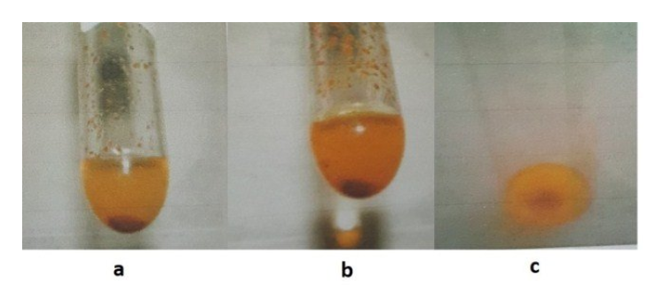
A : Wagner's test
B: Meyer’s test
C: Dragendroff's test

Slide 16


