Slide 1
Isolation of Anthraquinone Glycoside from Senna Leaves
Presented by ph Faten Essam

Slide 2
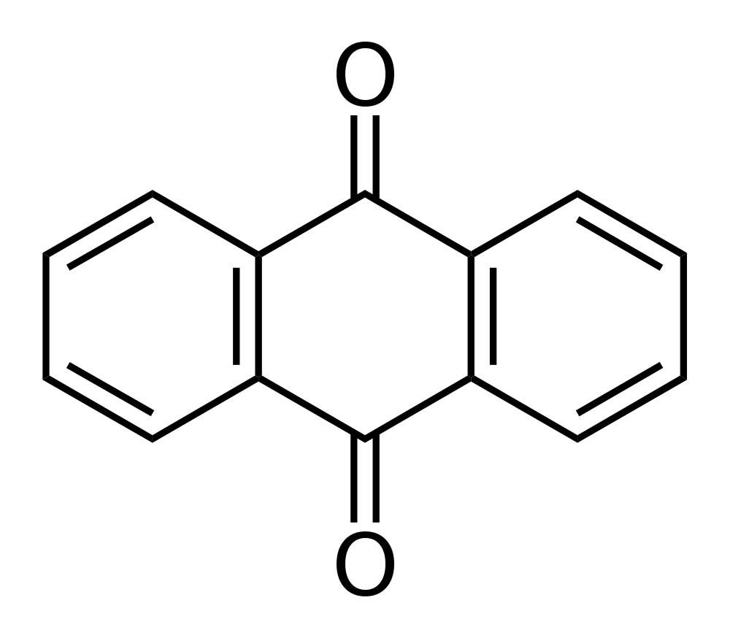
Anthraquinone
are glycoside which possess anthracene or its derivatives as aglycone part in which two ketone group are attached to benzene ring.
General anthraquinone structure

Slide 3
Anthraquinone and related glycosides are organic compounds found in some plants and have a stimulant cathartics effect , exert their action by increasing the tone of the smooth muscle in the wall of the colon and stimulate the secretion of the water and electrolytes into the large intestine.

Slide 4
After the oral administration, the Anthraquinone glycosides are hydrolyzed in the colon by the action of enzymes of the micro flora, to the pharmacologically active free aglycone which usually produce their effect in 8-12 hour after administration, these agents are indicated for constipation in patient who do not respond to milder drugs and for bowel evacuation before investigation procedures or surgery.

Slide 5
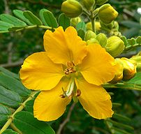
Plant used in this lab
common name : Senna
Scientific name : Cassia senna

Slide 6
Anthraquinone glycoside content
Sennoside A and Sennoside B( rhein dianthrone)
Sennoside C and Sennoside D( one molecule of rhein and one molecule of aloe-emodin )

Slide 7
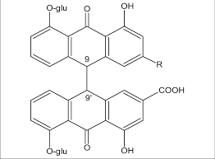

Slide 8
Medicinal Uses:
Cathartic
Treatment of irritable bowel syndrome
Treat skin disorder
Clean digestive from worms

Slide 9
## The phytoconstituents principally responsible for its characteristic action are two anthraquinone glycosides :
Sennoside A and Sennoside which together are responsible for up to 40 – 60% activity of crude senna.

Slide 10
Side effects:
Senna can cause some side effects including stomach discomfort, cramps, and diarrhea.
Longer use can cause the bowels to stop functioning normally and might cause dependence on laxatives.

Slide 11
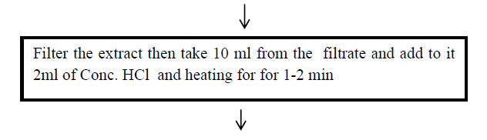
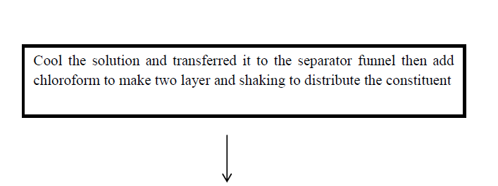
Procedure 0.5 gm of senna + 100 ml of water extracted by decoction method

Slide 12
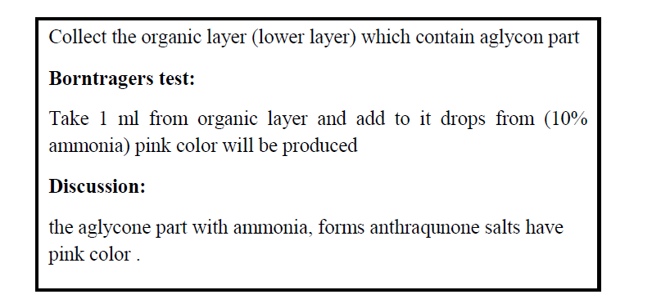

Slide 13


